Slide 1
Seat Back Collapse:
Why NHTSA Has No Data
Center for Auto Safety
Presentation to NTSB
August 2, 2016

Slide 2
Introduction
An occupied seat that meets Federal Motor Vehicle Safety Standard 207 (FMVSS 207) can and does fail in rear impacts. One need only look at FMVSS 301 rear impact test results to see seat back failures in 301 compliance tests. In 1974, NHTSA proposed adding the 301 rear impact test to 207 but dropped it.
Both front seat and rear seat occupants can be killed or seriously injured.
See “Collapsing Seatbacks And Injury Causation: A Timeline Of Knowledge”

Slide 3
NHTSA has Failed to Upgrade FMVSS 207 to Improve Seat Performance
Despite numerous petitions requesting that the agency upgrade FMVSS 207, NHTSA has failed to act for decades:
PIRG 1974 Petition
Saczalsky 1989 Petition
Cantor 1990 Petition
Bornemann 1997 Petition
NHTSA Termination of Rulemaking, 2004
2015 Cantor Petition remains unanswered past deadline
2016 CAS Petition is overdue
See NHTSA Seatback Rulemaking History for additional information

Slide 4
NHTSA Crash Data Deficiencies
Fatality Analysis Reporting System (FARS) relies on police accident reports (PARs), which do not include information on seating system performance.
National Automotive Sampling System (NASS) includes minimal seat performance information
Early Warning Reporting (EWR) includes “seat” as a contributing component, but fails to provide sufficient detail to determine any specifics of the crash. NHTSA has the authority to request more information on EWR crashes, but does so sporadically and does not make these investigations public.

Slide 5
NHTSA Has No Seat Back Data Because Neither PARs Nor FARS Reports on Seat Back Collapse
The fundamental problem is that NHTSA has no data source to show how many deaths and injuries occur every year due to seat back collapse. Based on an analysis of 64 seatback collapse lawsuits and police reports involving death and serious injury in rear impact crashes, the Center found police accident reporting rarely includes any comment on seatback failure even when it is obvious. (In only 2 of the 64 cases did the investigating officer cite seatback failure as a factor.) There is no place on a PAR for reporting such a failure other than the narrative description of the crash. And FARS does not even have a code for seat back collapse. This means that FARS also does not include any information on the role of seat performance in fatal crashes even if the PAR happened to reference it. The NASS coding for seat performance is minimal as well. As a consequence, an analysis of NASS and FARS cases that does not go beyond the recorded data will miss most crashes where poor seat performance contributed to injuries or fatalities.
CAS Letter to DOT Secretary Foxx – 3/11/16

Slide 6
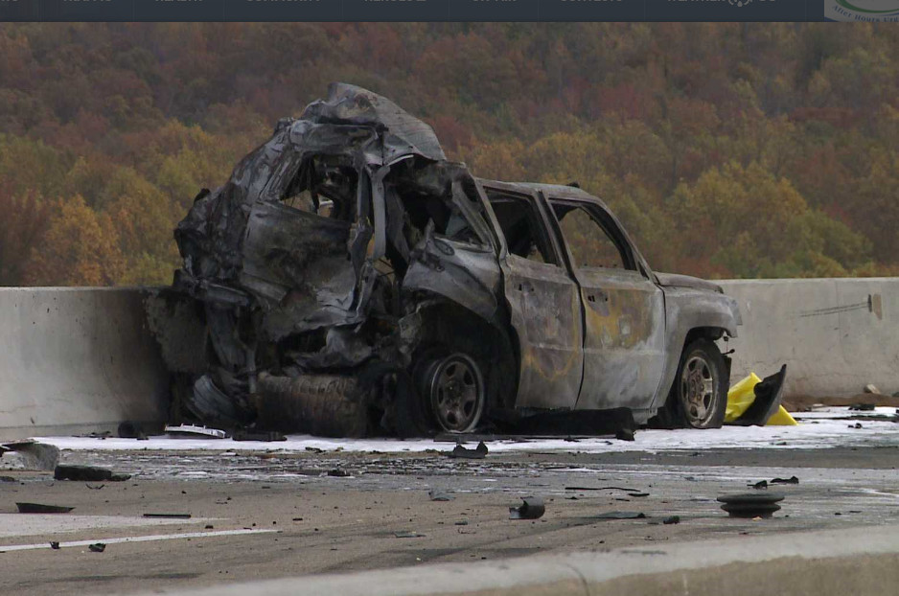
FARS Reliance on Police Accident Reports
FARS data are only as good as the Police Accident Reports on which they are based. This 2014 fiery crash in Virginia was originally coded in both the PAR and FARS as no fire, until CAS questioned the FARS coding. CAS has documented over a hundred FARS cases coded no fire or no MHE fire.

Slide 7
CAS Studies
NASS Study Charts – In March of 2016, CAS commissioned a study of child fatalities in rear impacts, finding that an average of 50 children were killed annually in the rear seat during rear impacts.
Friedman Study: Child Fatalities in Rear Impacts

Slide 8
EWR Study – CAS recently completed a review of Early Warning Reporting data submitted by ten major auto manufacturers. Over 300 deaths and 3000 injuries have been reported where “Seat” is a contributing component.
Early Warning Reporting - Deaths and Injuries with Seat as Contributing Component, 2003 Q3 – 2016 Q1
Manufacturer | Deaths | Injuries
BMW | 1 | 43
Chrysler | 55 | 383
Ford | 119 | 858
General Motors | 68 | 985
Honda | 15 | 240
Hyundai | 2 | 47
Kia | 11 | 82
Nissan | 18 | 113
Toyota | 28 | 402
Volkswagen/Audi | 4 | 33
Total | 321 | 3186

Slide 9
NHTSA EWR Excel Spreadsheets - Deaths & Injuries with Seat as Contributing Component
BMW
Chrysler
Ford
General Motors
Honda
Hyundai
Kia
Nissan
Toyota
Volkswagen/Audi

Slide 10
Conclusion
NHTSA itself recognizes that FARS cannot identify fatalities caused by some crash modes.
While NHTSA’s FARS database contains a census of all motor vehicle traffic fatalities, it does not contain the information needed to identify fatalities that resulted from drowning. Therefore, not only are the circumstances surrounding these drowning deaths uncertain, the frequency of such deaths is also unknown. (Austin, R., NHTSA. (2011). Drowning Deaths in Motor Vehicle Traffic Accidents. In 22nd International Technical Conference on the Enhanced Safety of Vehicles (ESV) (No. 11-0170). )
Until PARs are improved to have better quality data to feed into FARS, NASS and other analytical tools, NHTSA’s rulemaking and policy making will suffer from inadequate data that lead to erroneous conclusions and policies that do not adequately protect the public. Like a rising tide that floats all ships, better quality PARs improves all decision making at NHTSA
For more information, please visit the Center for Auto Safety’s Seat Back Collapse page at the following URL:
http://www.autosafety.org/nhtsa-urged-to-warn-parents-of-seat-back-failure-dangers-to-children-in-rear-seats/

